Slide 1


Task 2 – Carona Virus
Analysis Using SQL
BY : Layasri Batta
PROFILE: Data Analyst
BATCH : MIP-DA-07

Slide 2


Project Overview
The CORONA VIRUS pandemic has had a significant impact on public health and has created an urgent need for data-driven insights to understand the spread of the virus.
As a data analyst, my task is about analyzing a CORONA VIRUS dataset to derive meaningful insights and present my findings.
Through data analysis and statistical analysis, we can know the uncover patterns, trends and correlation within the dataset.
Our agenda is to learn the dataset and combating the COVID- 19 crisis.

Slide 3
Dataset Overview Description of each column in dataset
Province: Geographic subdivision within a country/region.
Country/Region: Geographic entity where data is recorded.
Latitude: North-south position on Earth's surface.
Longitude: East-west position on Earth's surface.
Date: Recorded date of CORONA VIRUS data.
Confirmed: Number of diagnosed CORONA VIRUS cases.
Deaths: Number of CORONA VIRUS related deaths.
Recovered: Number of recovered CORONA VIRUS cases.

Slide 4


Tools Used
Database Used
Management Tool used

Slide 5
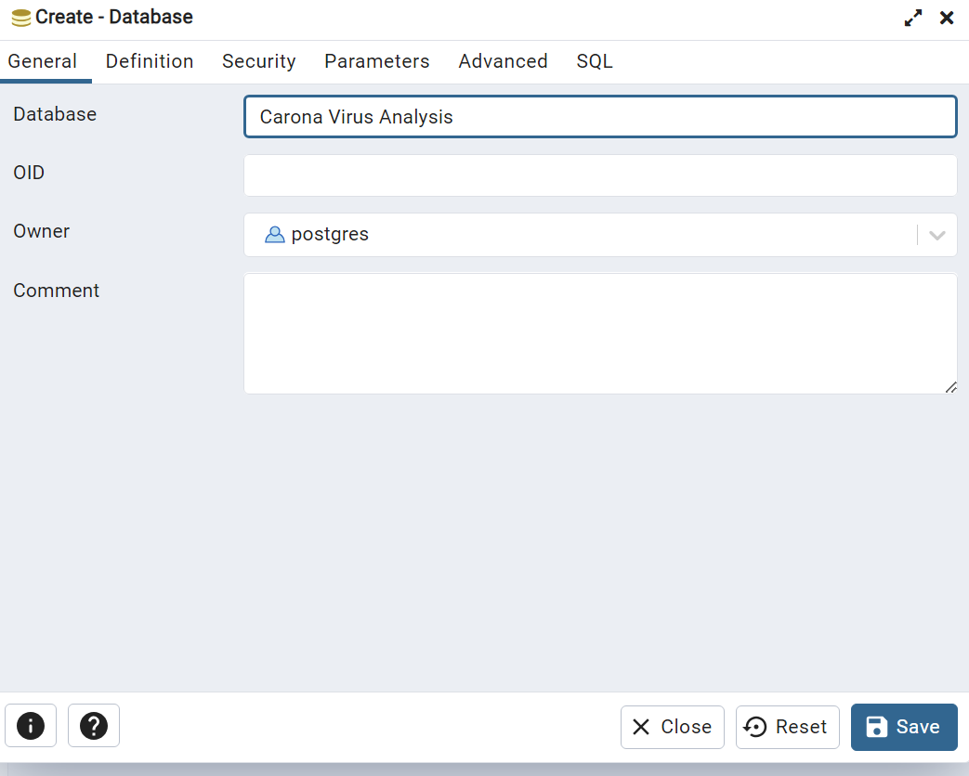
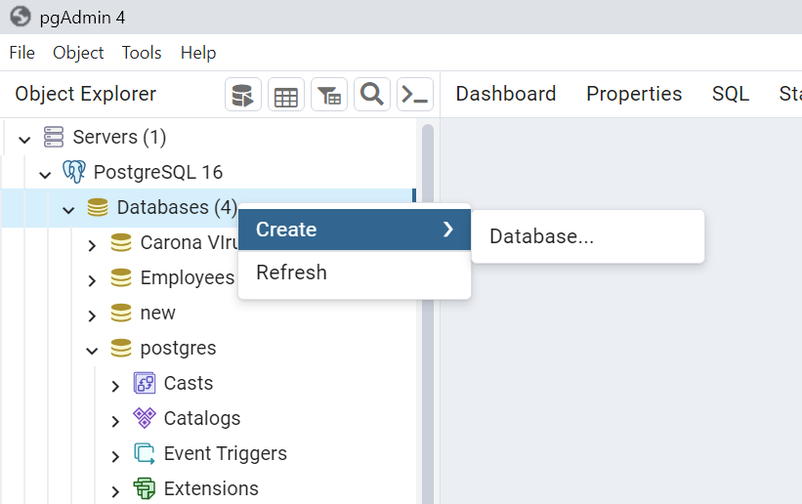
Database Setup To create a Database :
Database

Slide 6
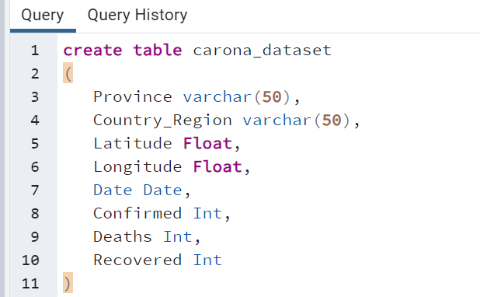
Create Table

Slide 7
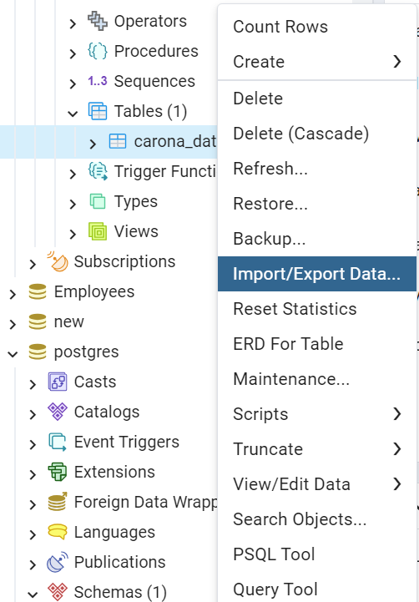
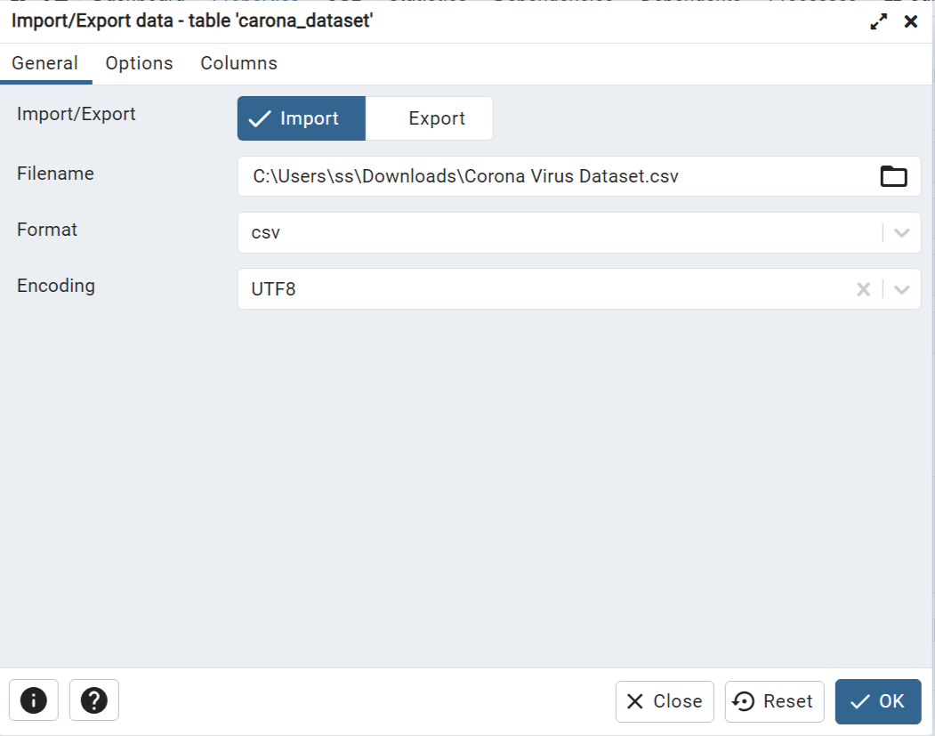
Import the dataset into the table

Slide 8
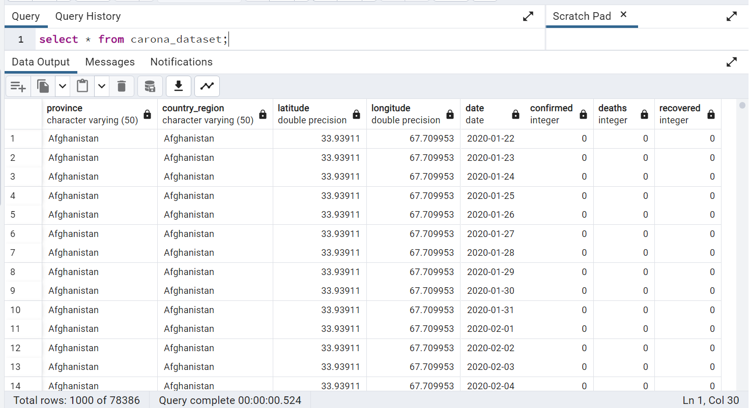
Data After Importing the Dataset

Slide 9
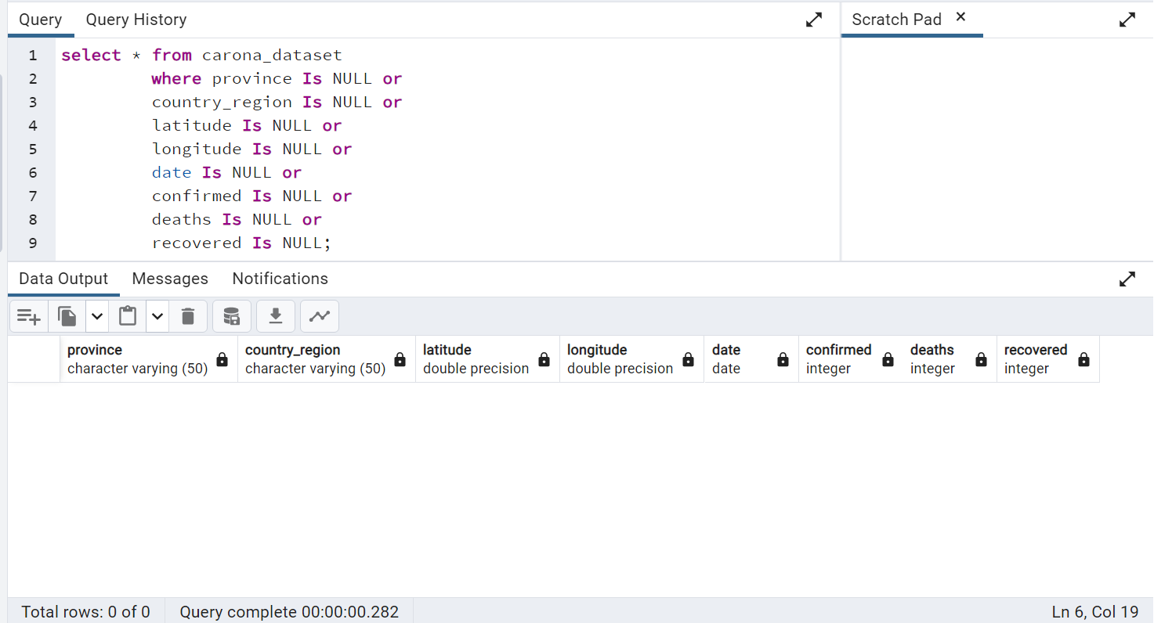
Data Cleaning
To avoid any errors, lets check missing values and null value in the dataset
Q1. Write a code to check NULL values
SQL query
Output

Slide 10
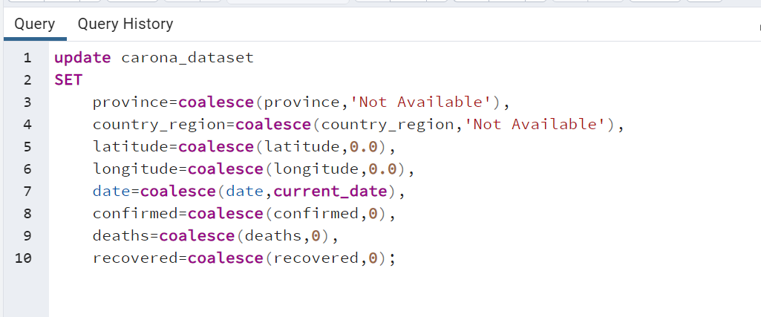
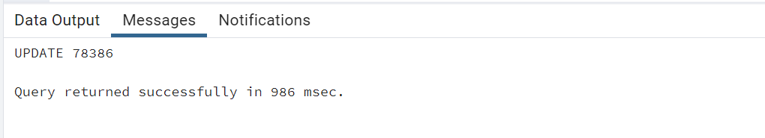
Q2. If NULL values are present, update them with zeros for all columns.
We have already seen that, there are no null values present in the dataset. Although if there are any we will replace them with the zeros by using the following code.

Slide 11
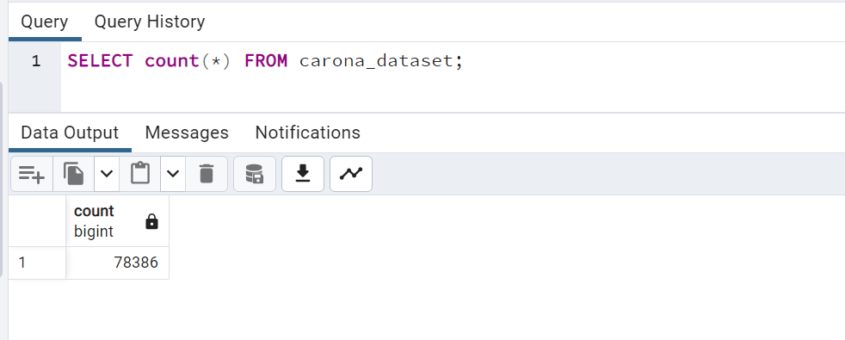
Q3. check total number of rows
Here we count the total number of rows present in the dataset using the count function.

Slide 12
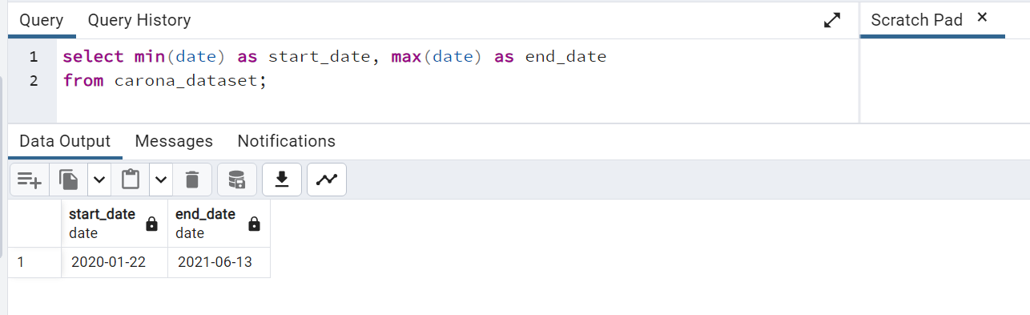
Q4. Check what is start_date and end_date
To know the start date and end date in the given we will use the Min and Max functions.

Slide 13
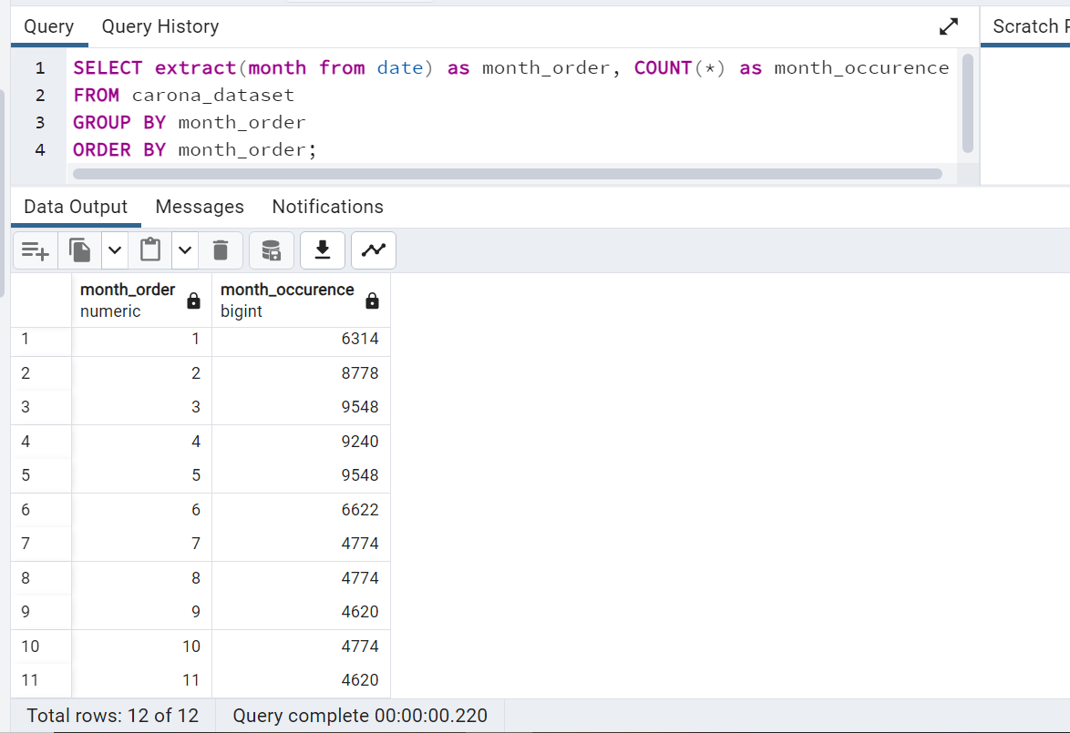
Q5. Number of month present in dataset
To know the number of months, we use the month_order
Month_order is used to know the month from JAN to DEC there in the dataset is represented in the numbers format.
Month_occurrence is used to count of the months occurred i.e the no.of cases withnessed in that month.

Slide 14
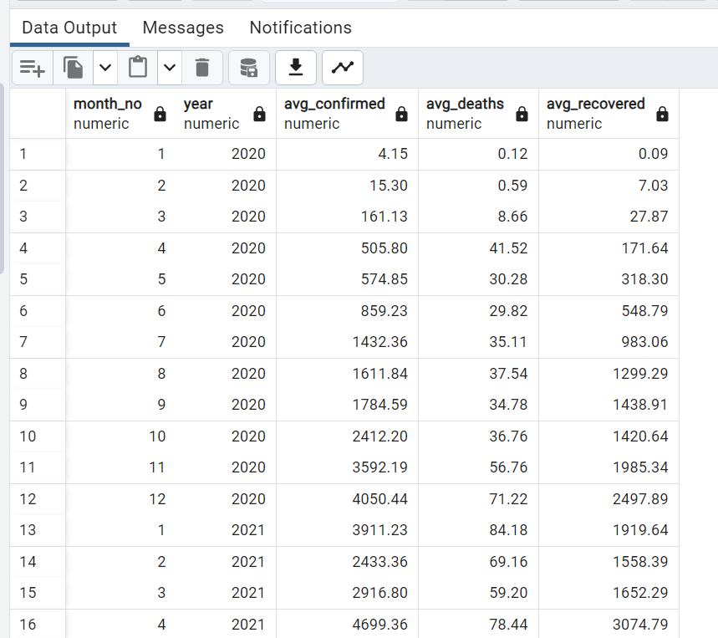
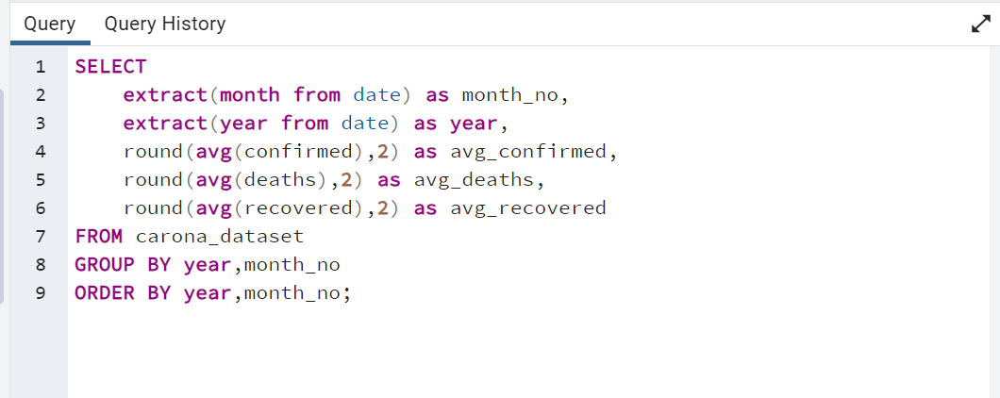
Q6. Find monthly average for confirmed, deaths, recovered
To know the average cases confirmed with respect to the month and year.
output

Slide 15
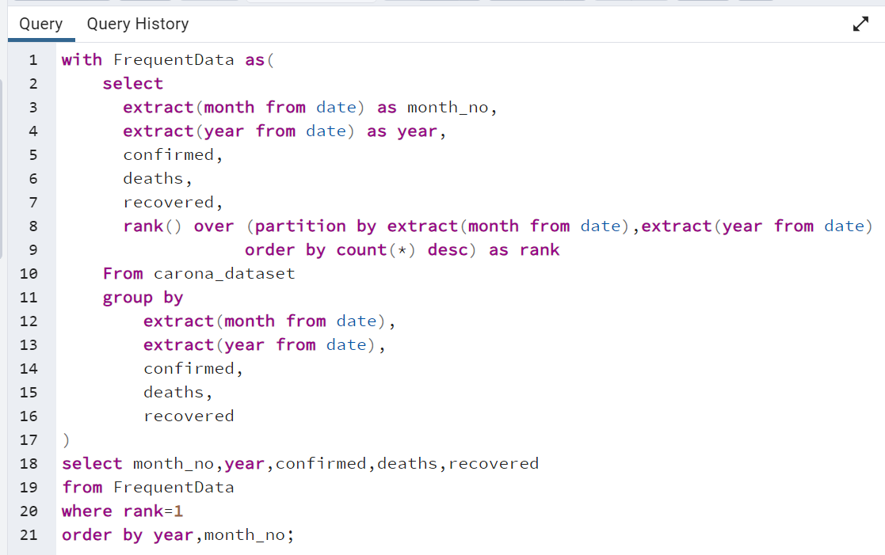
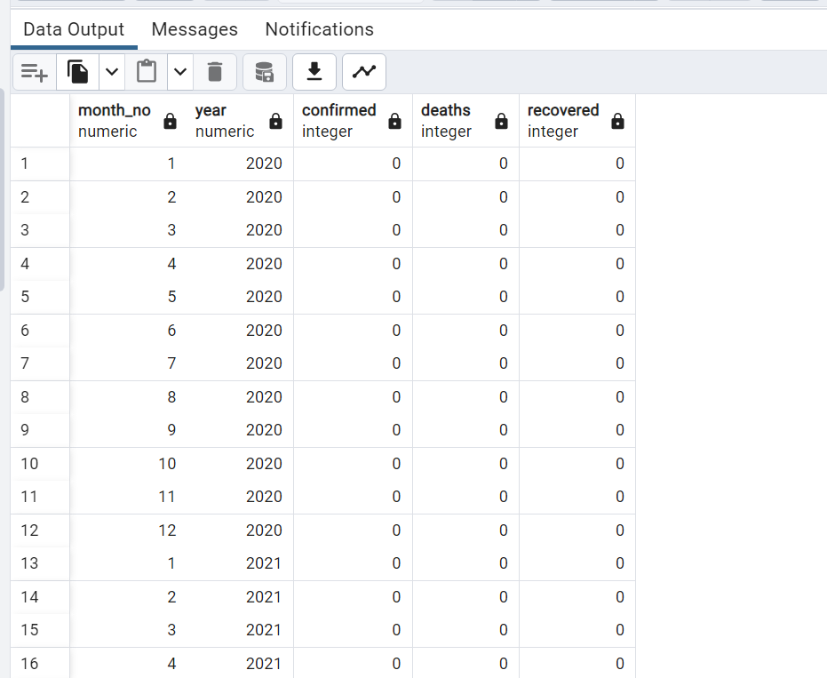
Q7. Find most frequent value for confirmed, deaths, recovered each month
Output

Slide 16
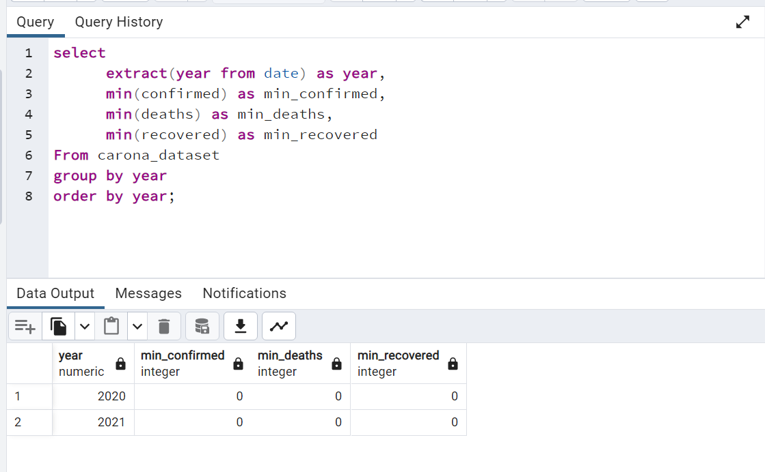
Q8. Find minimum values for confirmed, deaths, recovered per year

Slide 17
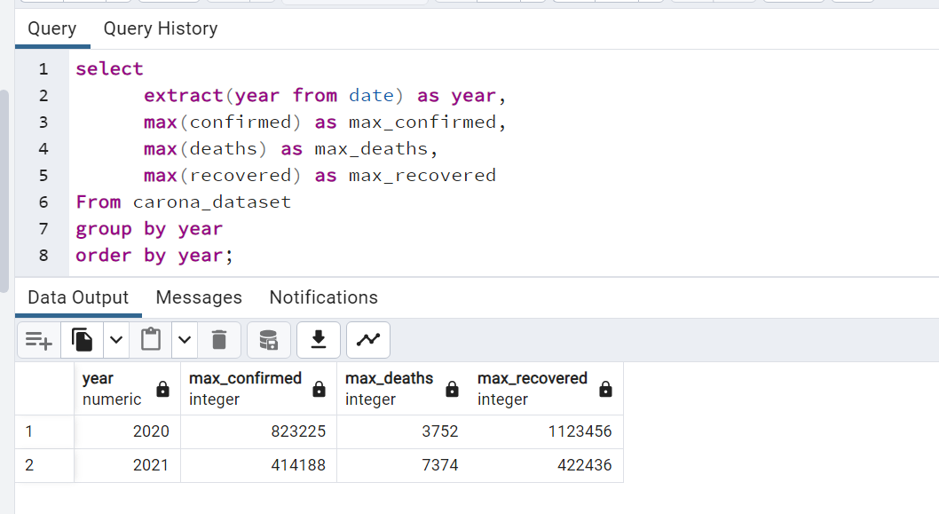
Q9. Find maximum values of confirmed, deaths, recovered per year
The maximum no.of cases confirmed in 2021 is half of the confirmed cases of 2020 as the precautions has been taken.
The max confirmed cases in 2020 is 823,225.
The max no.of cases recovered in 2020 are 1,123,456.

Slide 18
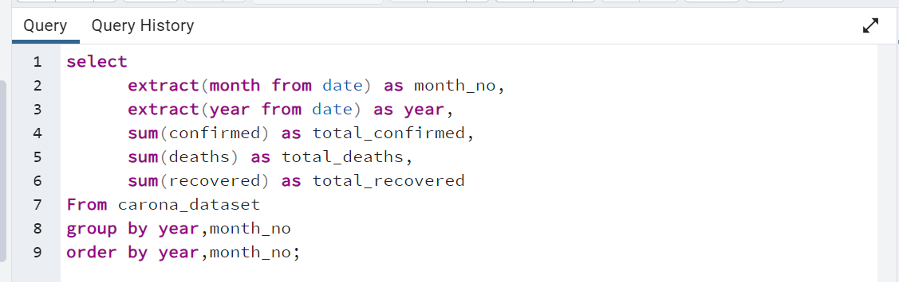
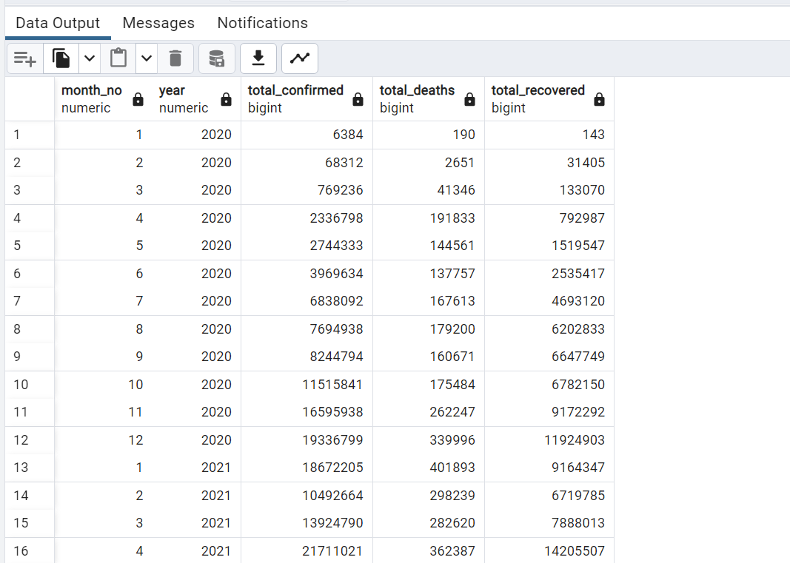
Q10. The total number of case of confirmed, deaths, recovered each month
Output
To know the confirmed, deaths and recovered cases every month by using the sum function.

Slide 19
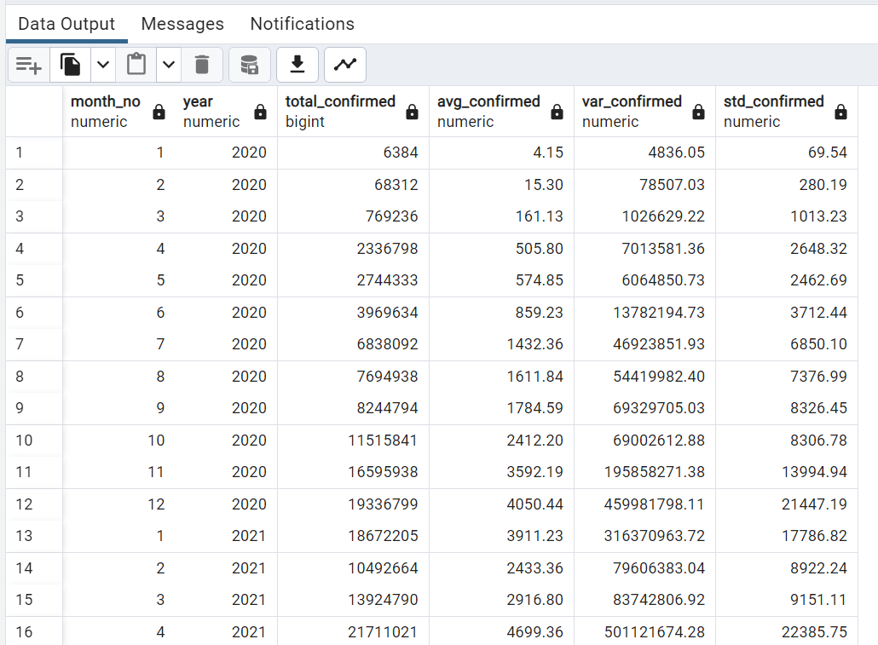
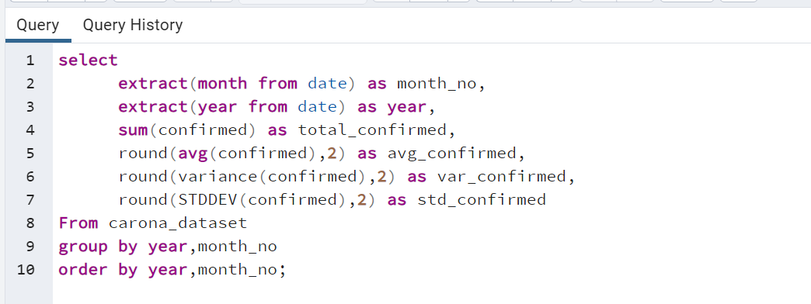
Q11. Check how corona virus spread out with respect to confirmed case (Eg.: total confirmed cases, their average, variance & STDEV )
Output

Slide 20
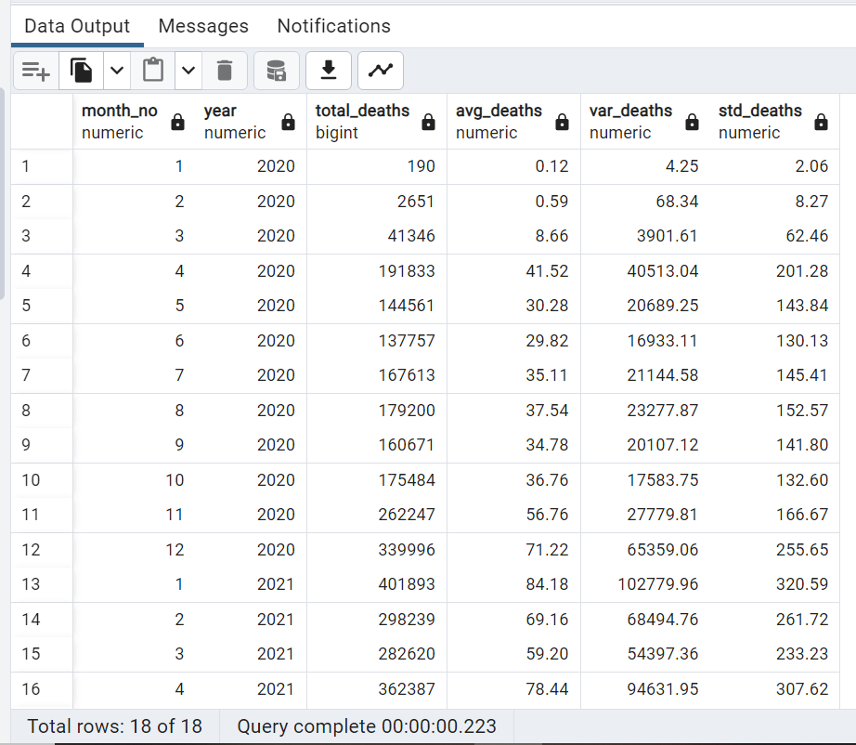
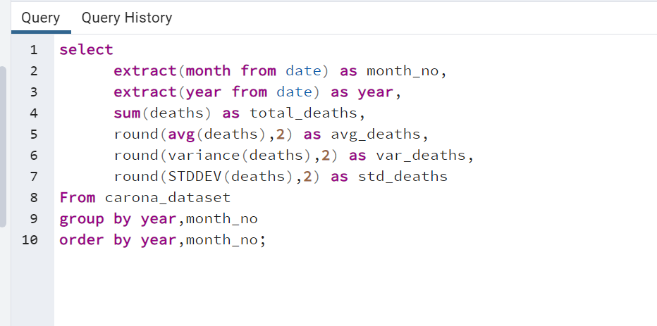
Q12. Check how corona virus spread out with respect to death case per month (Eg .: total confirmed cases, their average, variance & STDEV )
Output

Slide 21
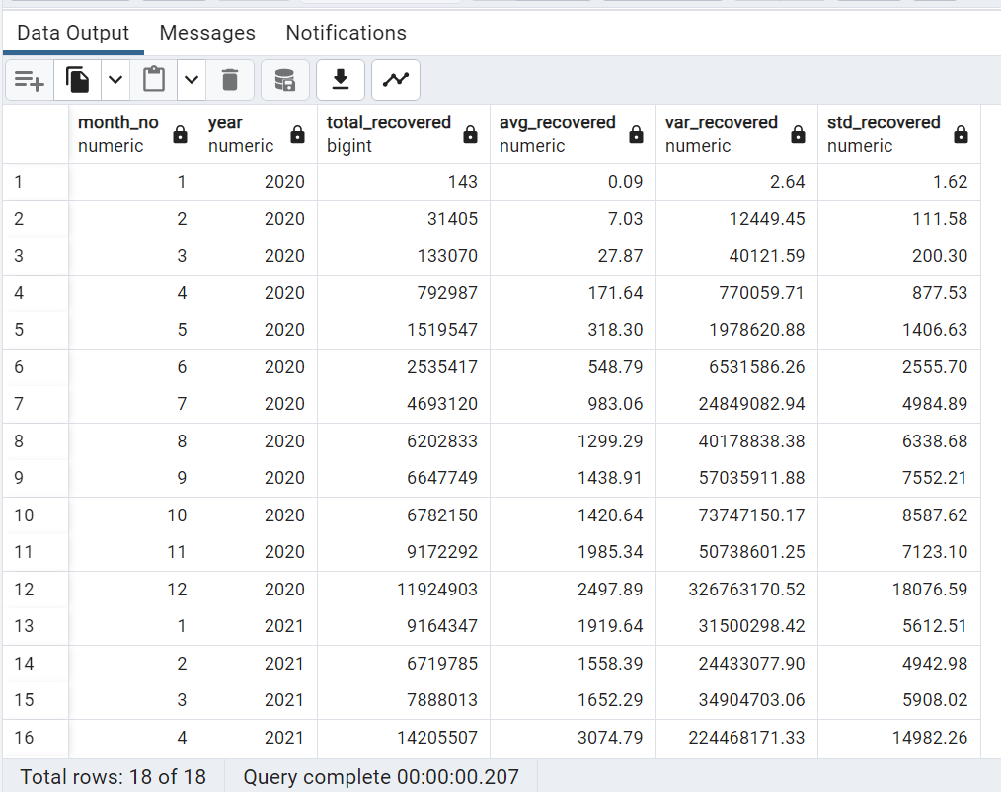
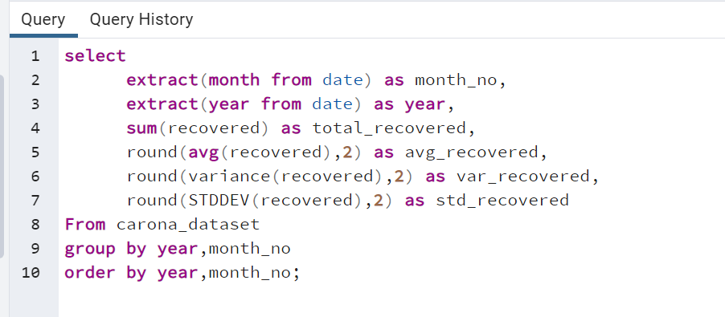
Q13. Check how corona virus spread out with respect to recovered case (Eg.: total confirmed cases, their average, variance & STDEV )
Output

Slide 22
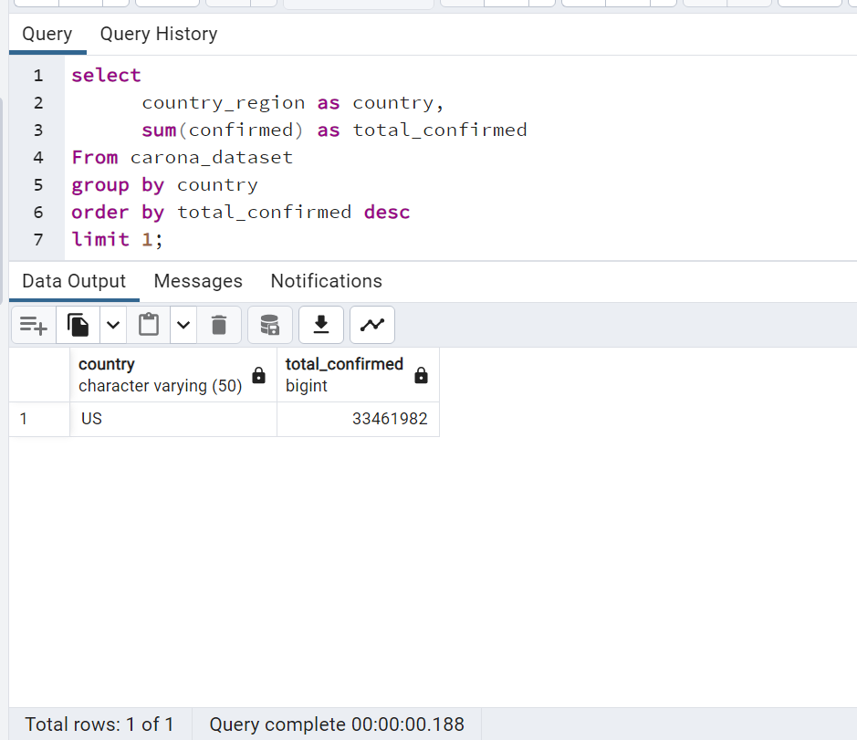
Q14. Find Country having highest number of the Confirmed case

Slide 23
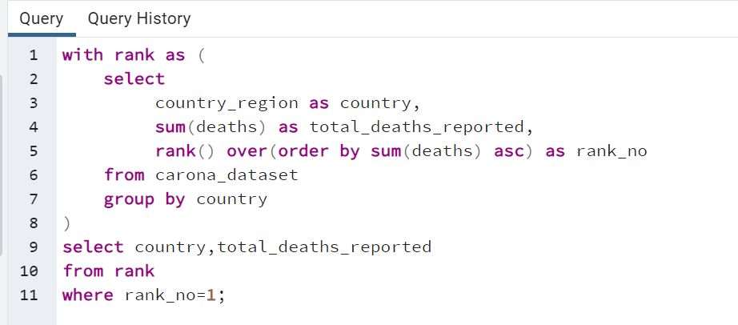
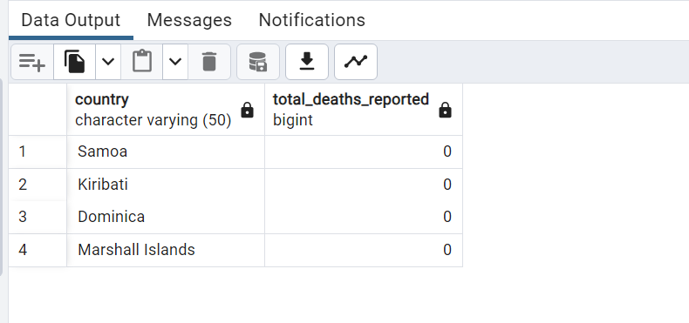
Q15. Find Country having lowest number of the death case
Output

Slide 24
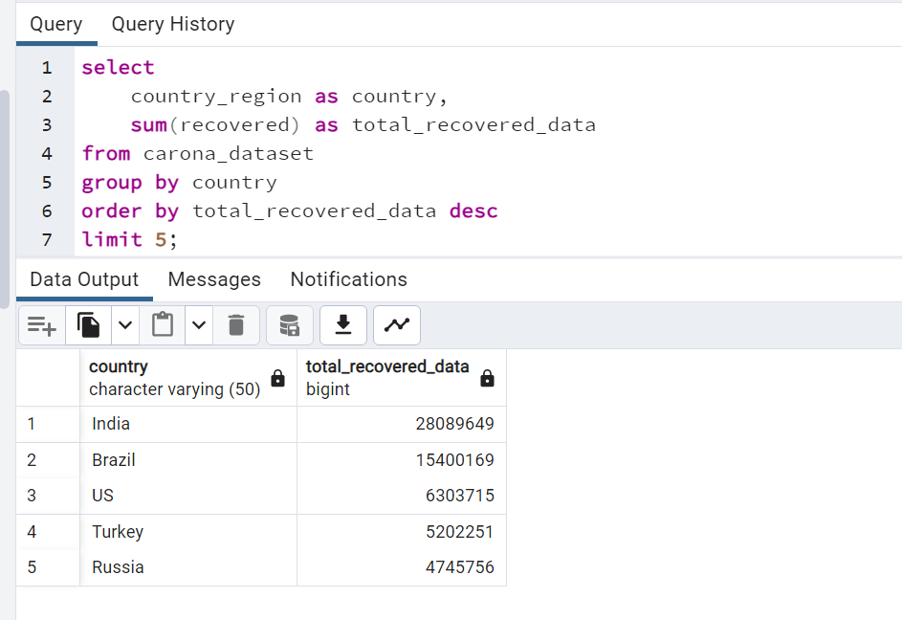
Q16. Find top 5 countries having highest recovered case

Slide 25


Slide 26


